Slide 1
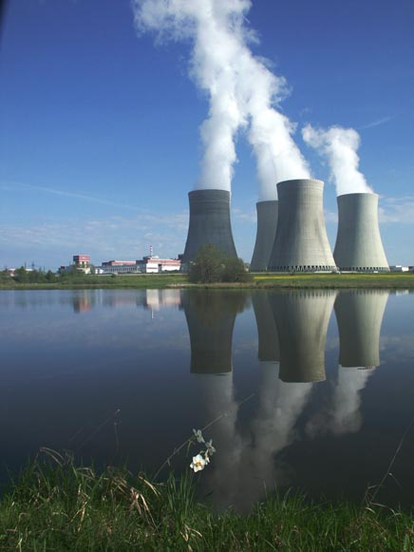
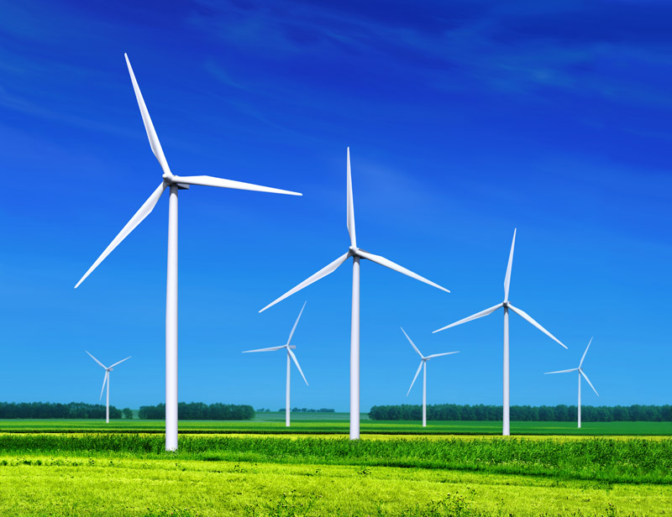
Environmental degradation
Wind farm

Slide 2


Slide 3
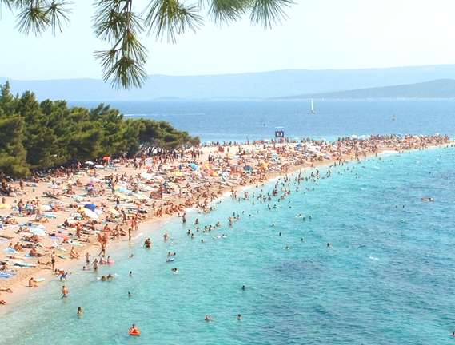


Slide 4
High standard
Entertainment
Relaxation

Slide 5

Spare parts
Netbooks
  Accessories
Software
Computers

Slide 6


Road signs
These signs tell the driver what to do in the place he is approaching. Signs indicating the direction of travel may be placed on the extension of the road axis (road) or on the road itself

Slide 7
Key Events
Acquisition
Consolidation
Reducing
the Cost
Increasing
Profits

